Slide 1
20 Jun

Slide 2
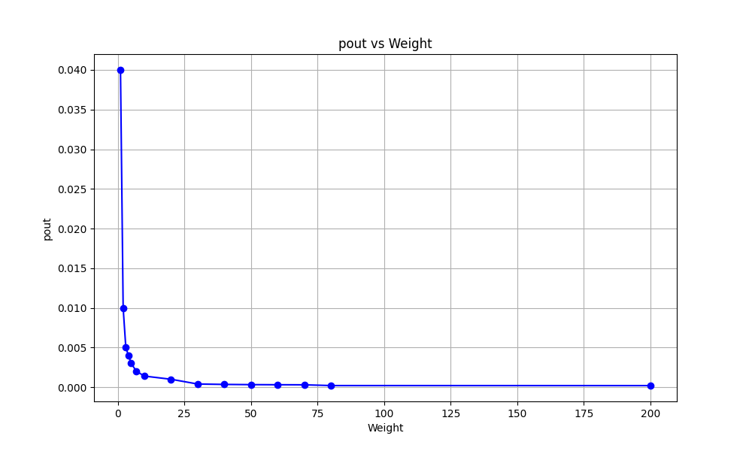
pout vs Weight Curve
weight | pout | mean | std_dev
1 | 0.04 | 0.26115 | 3.93E-17
2 | 0.01 | 0.25009 | 8.95E-09
3 | 0.005 | 0.25186 | 1.76E-16
4 | 0.004 | 0.26759 | 8.78E-17
5 | 0.003 | 0.22601 | 2.78E-17
7 | 0.002 | 0.23646 | 8.09E-17
10 | 0.0014 | 0.22838 | 1.52E-11
20 | 0.001 | 0.37404 | 5.63E-16
30 | 0.0004 | 0.21947 | 5.04E-16
40 | 0.00035 | 0.22895 | 9.41E-17
50 | 0.00032 | 0.34186 | 1.25E-15
60 | 0.00031 | 0.26469 | 3.07E-16
70 | 0.0003 | 0.25343 | 1.58E-15
80 | 0.0002 | 0.36557 | 2.78E-16
200 | 0.0002 | 6.87E-01 | 3.29E-16

Slide 3
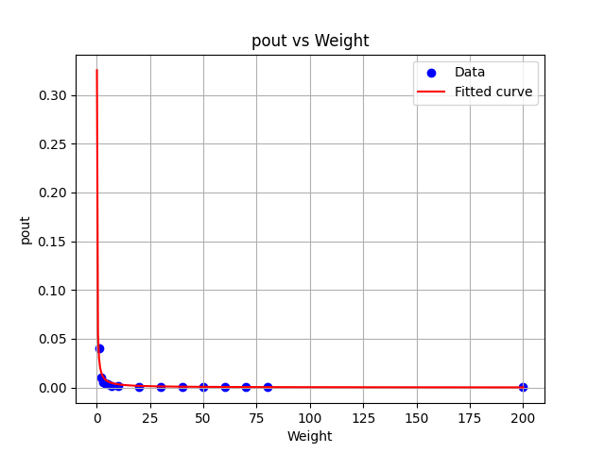
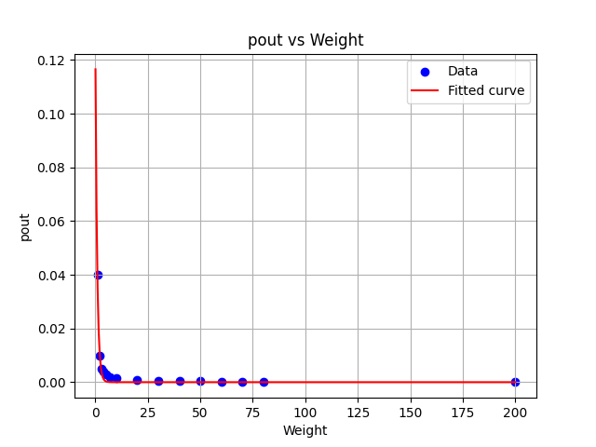
pout vs Weight Curve
Inverse function
Exponential function
MSE | Std_dev of MSE
1.0645216782498156e-05 | 0.0032627008417104616
MSE | Std_dev of MSE
1.8142642236507844e-06 | 0.001346946258634985

Slide 4

pout vs Weight Curve
For the fitted curve:
def improved_inverse_func(x, a, b, c): return a / (x + b) + c
Fitted parameters: a = 0.03253743417724307, b = 1.9097131806360358e-10, c = 1.999101143841673e-26
Something to note:
The dataset almost behaves as an inverse function
When weight < 1, pout goes ‘infinity’ (i.e., >0.5, which is infeasible in this case, =0.5 becomes Erdos-Renyi Graph )
$$pout≈\frac{0.032537}{weight}$$
weight | pout | mean | std_dev
0.02 | 0.45 | 0.000217 | 2.29E-19
0.02 | 0.5 | 0.000219 | 1.71E-07
0.02 | 0.9 | 0.000239 | 6.90E-19
0.2 | 0.14 | 0.01774 | 5.49E-18
0.2 | 0.5 | 0.021916 | 1.65E-06
0.2 | 0.9 | 0.023916 | 1.43E-17
0.5 | 1 | 0.15086 | 3.93E-17

Slide 5

pout vs Weight Curve
For the fitted curve:
def exp_decay(x, a, b): return a * np.exp(-b * x)
Fitted parameters: a = 0.13138909641598337, b = 1.1983420369707432
Something to note:
The dataset almost behaves as an exponential function
When weight < 1, pout goes ‘infinity’ (i.e., >0.5, which is infeasible in this case, =0.5 becomes Erdos-Renyi Graph )
$$pout≈{0.131389×e}^{−1.198342×weight}$$
weight | pout | mean | std_dev
0.02 | 0.45 | 0.000217 | 2.29E-19
0.02 | 0.5 | 0.000219 | 1.71E-07
0.02 | 0.9 | 0.000239 | 6.90E-19
0.2 | 0.14 | 0.01774 | 5.49E-18
0.2 | 0.5 | 0.021916 | 1.65E-06
0.2 | 0.9 | 0.023916 | 1.43E-17
0.5 | 1 | 0.15086 | 3.93E-17

Slide 6
pout vs Weight Curve
Continue last page:
The regression function shows that the curve converges to 0 but while pout become incredible small, the error would perfectly converge to almost 0.
From the table in Page 2, it converges to 0.0001.
weight | pout | mean | std_dev
200 | 0.0001 | 3.79E-25 | 5.02E-27
2000 | 0.00001 | 3.91E-23 | 6.30E-25
2000 | 0.000122 | 1.99E-22 | 1.13E-25

Slide 7
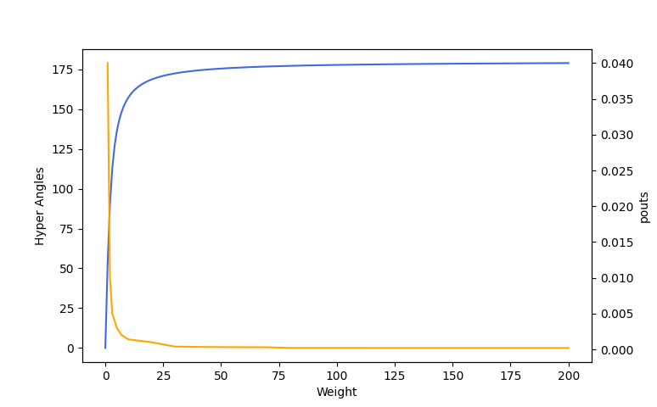
pout vs Weight Curve
The trend for such convergence on pout coincide with the correlation relationship between the two blocks of datapoints.
Hyper angles
pouts

